Slide 1
Computer Vision Fundamentals
Lecture 2 - Part 2
Matrices in MATLAB

Slide 2
Contents
Writing a Matrix in MATLAB
Matrix elements and ‘ORDER’
Matrix operations
Inverse and transpose
FLIPUD( ), FLIPLR( ), ROT90( )
RESHAPE( )
DOT operator
MATRIX constructors

Slide 3
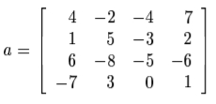
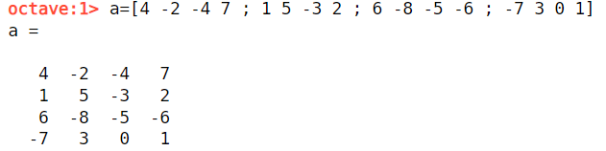
Writing a Matrix in MATLAB
AS A PROGRAMMER, REMEMBER ‘;’ AGAIN!
>> a=[4 -2 -4 7 ; 1 5 -3 2 ; 6 -8 -5 -6 ; -7 3 0 1]

Slide 4

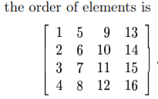

Matrix elements and ‘ORDER’
>> a ( 2 , 3 )
ans = -3
>> a ( 4 , 2 )
ans = 3
>> a ( 10 )
ans = 3

Slide 5
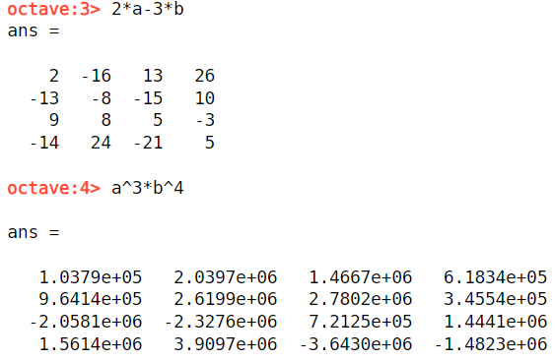
Matrix operations
>> a=[4 -2 -4 7 ; 1 5 -3 2 ; 6 -8 -5 -6 ; -7 3 0 1]
>> b=[2 4 -7 -4;5 6 3 -2;1 -8 -5 -3;0 -6 7 -1]
>> 2*a-3*b
>> a^3*b^4

Slide 6
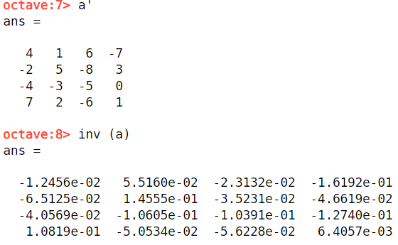
Inverse and transpose
>> inv ( a )
>> a’

Slide 7
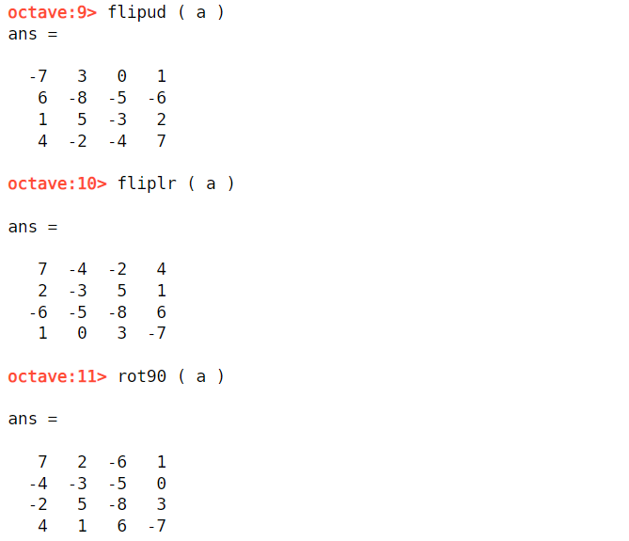
FLIPUD, FLIPLR, ROT(90)
>> flipud ( a )
>> fliplr ( a )
>> rot90 ( a )

Slide 8
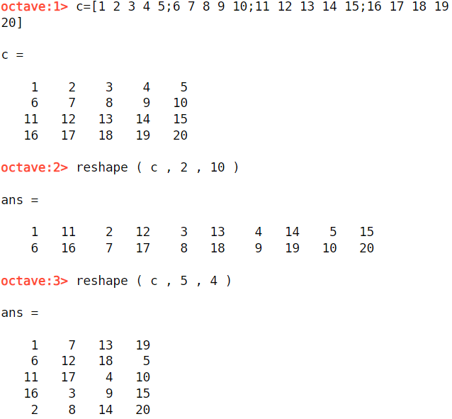
RESHAPE
The reshape function produces a matrix with elements taken column by column from the given matrix.
>> c=[1 2 3 4 5;6 7 8 9 10;11 12 13 14 15;16 17 18 19 20]
>> reshape ( c , 2 , 10 )
>> reshape ( c , 5 , 4 )

Slide 9
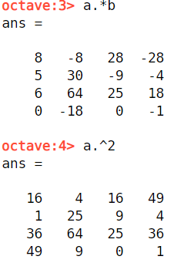
DOT operator
Dot operator produces the matrix whose elements are the ‘outputs’ of the corresponding elements of a and b.
It can either be
Multiplication
Squaring
Reciprocals
And alot more…..
>> a . * b
>> a . ^2

Slide 10
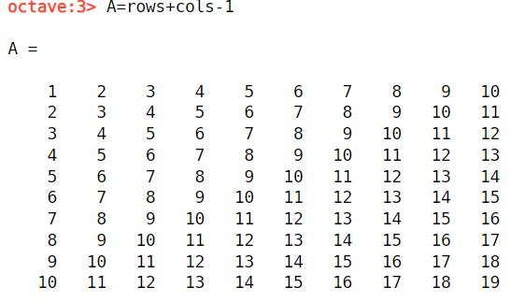
Matrix constructors
>> rows=(1:10)’*ones(1,10)
>> cols=ones(10,1)*(1:10)
>> A=rows+cols-1
We have seen that we can construct matrices by listing all their elements. However, this can be tedious if the matrix is large, or if it can be generated by a function of its indices.
Two special matrices are the matrix consisting of all zeros, and the matrix consisting of all ones. These are generated by the zero and ones functions respectively
Matrices of random numbers can be produced using the rand and randn functions. They differ in that the numbers produced by rand are taken from a uniform distribution on the interval and those produced by randn are take from a normal distribution with mean zero and standard deviation

Slide 11
Thankyou

